Slide 1
Presentation on 8-bit mips Processor
Group - A05
Ashna Jain (201501008)
Charmi Chokshi (201501021)
Manasi Dubey (201501051)

Slide 2
DEFINITION OF OUR MICROPROCESSOR
8-bit RISC based single core pipelined microprocessor WHICH CAN BE USED TO PERFORM VARIOUS ARITHMATIC and logical OPERATIONS.

Slide 3
MOTIVATION
To relate the theory and practical aspects of computer organisation.
To understand the concepts of Microprocessor Without Interlocked Pipelined Stages(mips).
Willingness to create a micro-processor.
Marks
Practical knowledge regarding MIPS and 8085.

Slide 4
Specifications
Bit - 8
Instructions - 28
Registers - 32
Address bit - 8
Frequency - 1Mhz
Instruction set architecture – RISC
Addressing mode - Direct, Register Direct, Immediate Direct
Instruction format – I - Type, R - Type, J - Type

Slide 5
Specifications continued...
INSTRUCTION FORMATS:
R type
I type
- J type
Op_dec (5 bits) | Rw (5 bits) | Rb(5 bits) | Ra(5 bits)
Op_dec(5 bits) | Rw(5 bits) | Rb(5 bits) | Immediate(5 bits)
Op_dec(5 bits) | Jump_address(15bits)

Slide 6
Specifications Continued....
CPI –
For very large number of instructions – 1
For our addition program – 1
For our multiplication program - 1.538
Speed-up factor - 5
Number of pins –
Input – 11
Output - 8
Clock period - 1000 nano second

Slide 7

Block diagram of microprocessor
The Block diagram includes various blocks or parts of micro-processor which performs their specific jobs. These blocks are-
Jump control block, stall control block, program counter, register bank, dependency check block, data memory, write back and execution block.
Click here for the block diagram

Slide 8
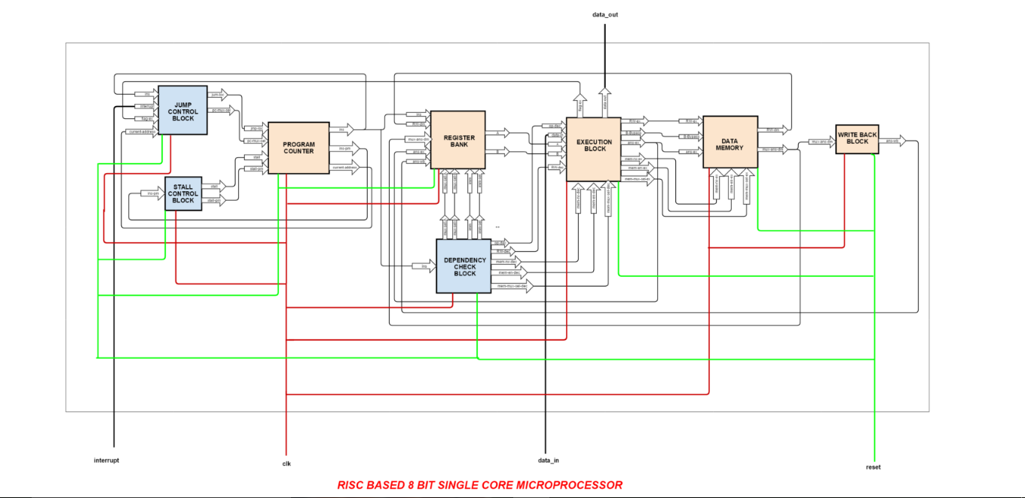
Link for the online diagram:
https://www.gliffy.com/go/share/image/snnodv6gfuwj9gk4egpr.png?utm_medium=live-embed&utm_source=googleapps

Slide 9
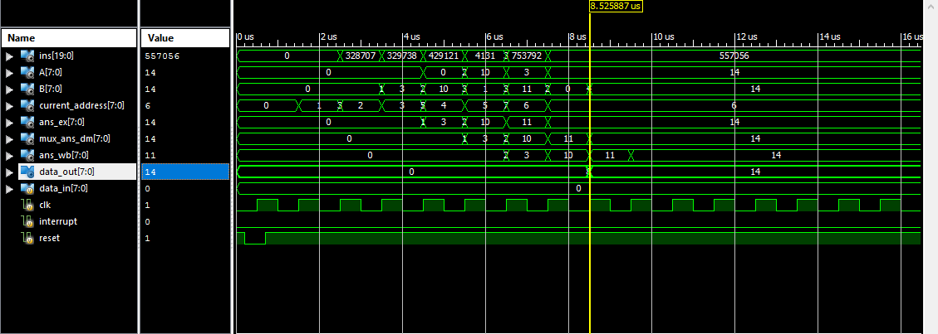
OUTPUT OF ADDITION(POST-ROUTE)

Slide 10
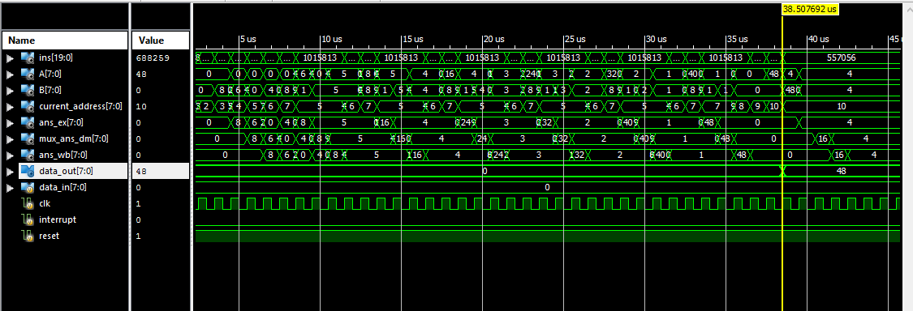
OUTPUT OF MULTIPLICATION (POST-ROUTE)

Slide 11
ADVANTAGES OF OUR MICROPROCESSOR
Has more number of registers than 8085, so it can store more data.
Our processor is pipelined.
As our processor is RISC based so it is faster than 8085.

Slide 12
DISADVANTAGES OF OUR MICROPROCESSOR
Clock period of our microprocessor is more as compared to 8085.
Our processor can not communicate with the external world.
Our processor has less number of pins as compared to 8085.
As data memory and program memory are separate in our processor it takes more time to execute a instruction as compared to 8085 which has combined memory.
Our processor has less number of instructions as compared to 8085.

Slide 13
Comparison of our design with 8085
8085 | Processor
8 bit data bus | 8 bit data bus
frequency : 3-6 Mhz | 1 Mhz
Semi - CISC | RISC
Non-pipelined | Pipelined
6 Registers | 32 Registers
16 bit address line | 20 bit address line
80 instructions | 28 instructions
Accumulator : 8 bit | Accumulator : not present
Architecture : Neumann | Architecture : Harvard

Slide 14
Challenges faced during design and implementation
Removing the if...else blocks from whole code.
Showing the warnings of some missing files even though the files were present in the project folder.
Differences between thinking of group members.
To understand the concept and logic behind the design.
To analyze the output of the design.

Slide 15
FEEDBACK /SUGGESTIONS
Manan sir and Parth sir were very helpful to us in all the lab sessions.
As an engineer, we had a good experience to explore the internal parts of a processor.
If you can please try to design a code which can be dumped on FPGA.
We can include the interrupt block so as to take any interrupt value.
Overall it was a good experience.

Slide 16
THANK YOU...☺☺☺

